Slide 1
Apologetics… Defending the Faith
Scripture in Support of Our Catholic Beliefs
Session 2
The Ten Commandments and Idolatry

Slide 2
Why Apologetics?
Jesus teaches us…
“Go therefore and make disciples of all the nations, baptizing them in the name of the Father and the Son and the Holy Spirit”
Matthew 28:19
Notes:
We are instructed by Jesus himself to go and make disciples of all the nations.
It’s our job to evangelize our faith to ALL NATIONS… that means EVRYONE!

Slide 3
Why Apologetics?
Paul teaches us…
“…but sanctify Christ as Lord in your hearts. Always be ready to give an explanation to anyone who asks you for a reason for your hope,”
1 Peter 3:15
Notes:
Paul instructed to defend and explain our faith in the scriptures…
He writes in his first letter to Peter to always be ready to defend the faith…

Slide 4
Why Apologetics?
…but do it with gentleness and reverence, keeping your conscience clear, so that, when you are maligned, those who defame your good conduct in Christ may themselves be put to shame.
1 Peter 3:16
Notes:
But, always be gentle and loving in your discourse…
Always do it with gentleness and reverence. Never debate.
Question, understand then explain. Listen for the other point of view, then gently explain yours. Never let it come down to right or wrong, let it be about interpretation. This is how I see it, that is how you see it. Once you put the other person on the defensive, you have lost your advantage and they will likely become obstinate and closed minded.

Slide 5
Be Armed and Ready
Remember:
NOTHING in the teachings of the Catholic Church contradicts ANYTHING in the Bible.
NOTHING in the Bible contradicts ANY of the teachings of the Catholic Church.
Notes:
GET THIS INTO YOUR HEADS!
This is your armor. When you understand this, you cannot be beaten.
Protestant theology says we are all free to interpret the Bible as we see fit in our own way. That belief will force them to concede that your interpretation is as at least as good as theirs.
John Marignoni says that with this understanding the best your opponent can hope for is a tie, and the worst you an suffer is a tie.
It can only come down to “well, that’s my interpretation.”

Slide 6
Be Armed and Ready, but Willing to Retreat
Never be afraid to say:
I don’t know, but I’ll find out and get back to you.
You have all the answers backed by the “the church of the living God, the pillar and foundation of truth.”
So FIND OUT and GET BACK TO THEM
Notes:
Now you have the advantage.
Find out and GET BACK TO THEM!
You can look it up. Do the research, find a talk by Scott Hahn or John Martignoni and give it to them.
You have all the answers backed by the “the church of the living God, the pillar and foundation of truth.”
But ALWAYS GET BACK TO THEM!
I got into a discussion with a guy at the Rally for Life down in Columbia a few years ago.
I made the mistake once of giving the guy my e-mail address but not getting his…
He told me he would send me his e-mail and finish the discussion but he never did.
I imagine he told some friend of his about his discussion with a Catholic and the friend probably told him to drop it
I never could finish what I had to say to him and I’ve regretted it ever since.
I hope what I did tell him might have sparked some interest, but I will never know.
ALWAYS GET BACK TO THEM!

Slide 7
Getting Started
Let’s start with a simple topic that has some easily justifiable answers:
The Ten Commandments
Notes:
Let’s start with a simple topic that has some easily justifiable answers: The Ten Commandments.
Now, there are so many other ramifications that this topic has, and so much that you can research, and discuss, but I’m going to talk about a common misconception between Protestants and Catholics that is a basis for disagreement between us and how to present the Catholic side..

Slide 8
A Common Misunderstanding
Catholics threw out the second commandment so they could justify idol worship.
Protestants modified the first commandment to justify their stance that Catholics are idolaters.
Both statements are patently false.
Notes:
A common misunderstanding between Catholics and Protestants is the order and content of the ten commandments, the chief issue being the practice of worshiping idols.
Protestants claim that the Catholic Church threw out the second commandment because it did not agree with their practice of worshiping idols.
Some Catholics claim that Protestants specifically reorganized the first commandment to prove scripturally that Catholics worship idols.
Both statements are completely false.
First, the Lutheran Church was the first church to protest Catholicism and split from the Catholic Church and while Luther eventually did throw out seven books of the Old Testament, and rearranged a bit of text to better suit his personal beliefs, he did not change the Ten Commandments and in fact, the Lutheran Church today holds to the same order and listing of the Commandments as the Catholic Church.

Slide 9
A Common Misunderstanding
Catholic 10 Commandments
Protestant 10 Commandments
You shall have no other Gods before me
Do not take the Lords name in vain
Remember the Sabbath and keep it holy
Honor your mother and father
You shall not murder
You shall not commit adultery
You shall not steal
You shall not bear false witness against your neighbor
You shall not covet your neighbors wife
You shall not covet your neighbors property
You shall have no other gods but me.
You shall not make unto you any graven images
You shall not take the name of the Lord your God in vain
You shall remember the Sabbath and keep it holy
Honor your mother and father
You shall not kill
You shall not commit adultery
You shall not steal
You shall not bear false witness
You shall not covet anything that belongs to your neighbor
Notes:
These are the popular, abbreviated versions of the ten commandments as outlined by the Catholics Church and as popularized by most Protestant Churches after their split from Luther.
The two major differences are in red.

Slide 10
What Does the Bible Say?
Exodus 20:1-7
Catholic Bible (NABRE)
Protestant Bible (AKJV)
Then God spoke all these words:
I am the LORD your God, who brought you out of the land of Egypt, out of the house of slavery.
You shall not have other gods beside me.
You shall not make for yourself an idol or a likeness of anything in the heavens above or on the earth below or in the waters beneath the earth;
you shall not bow down before them or serve them. For I, the LORD, your God, am a jealous God, inflicting punishment for their ancestors’ wickedness on the children of those who hate me, down to the third and fourth generation;
but showing love down to the thousandth generation of those who love me and keep my commandments.
You shall not invoke the name of the LORD, your God, in vain. For the LORD will not leave unpunished anyone who invokes his name in vain.
And God spake all these words, saying,
I am the Lord thy God, which have brought thee out of the land of Egypt, out of the house of bondage.
Thou shalt have no other gods before me.
Thou shalt not make unto thee any graven image, or any likeness of any thing that is in heaven above, or that is in the earth beneath, or that is in the water under the earth:
thou shalt not bow down thyself to them, nor serve them: for I the Lord thy God am a jealous God, visiting the iniquity of the fathers upon the children unto the third and fourth generation of them that hate me;
and shewing mercy unto thousands of them that love me, and keep my commandments.
Thou shalt not take the name of the Lord thy God in vain; for the Lord will not hold him guiltless that taketh his name in vain.
Notes:
Lets compare the scripture that contains the ten commandments as Moses brought them down from the mountain from God.
This is the first recording of the commandments from Exodus 20
These are copied directly out of the United States Conference of Catholic Bishops on-line Bible, the New American Bible, Revised Edition and the Protestant Authorized King James Version.

Slide 11
What Does the Bible Say?
Exodus 20:8-17
Catholic Bible (NABRE)
Protestant Bible (AKJV)
Remember the Sabbath day—keep it holy.
six days you may labor and do all your work,
but the seventh day is a Sabbath of the LORD your God. You shall not do any work, either you, your son or your daughter, your male or female slave, your work animal, or the resident alien within your gates.
For in six days the LORD made the heavens and the earth, the sea and all that is in them; but on the seventh day he rested. That is why the LORD has blessed the Sabbath day and made it holy.
Honor your father and your mother, that you may have a long life in the land the LORD your God is giving you.
You shall not kill.
You shall not commit adultery.
You shall not steal.
You shall not bear false witness against your neighbor.
You shall not covet your neighbor’s house. You shall not covet your neighbor’s wife, his male or female slave, his ox or donkey, or anything that belongs to your neighbor.
Remember the Sabbath day, to keep it holy.
Six days shalt thou labour, and do all thy work:
but the seventh day is the Sabbath of the Lord thy God: in it thou shalt not do any work, thou, nor thy son, nor thy daughter, thy manservant, nor thy maidservant, nor thy cattle, nor thy stranger that is within thy gates:
for in six days the Lord made heaven and earth, the sea, and all that in them is, and rested the seventh day: wherefore the Lord blessed the Sabbath day, and hallowed it.
Honour thy father and thy mother: that thy days may be long upon the land which the Lord thy God giveth thee.
Thou shalt not kill.
Thou shalt not commit adultery.
Thou shalt not steal.
Thou shalt not bear false witness against thy neighbour.
Thou shalt not covet thy neighbour’s house, thou shalt not covet thy neighbour’s wife, nor his manservant, nor his maidservant, nor his ox, nor his ass, nor any thing that is thy neighbour’s.
Notes:
Notice that except for obvious differences in language, the verses are identical in content.

Slide 12
What Does the Bible Say?
Deuteronomy 5:6-21
Protestant Bible (AKJV)
I am the Lord thy God, which brought thee out of the land of Egypt, from the house of bondage.
Thou shalt have none other gods before me.
Thou shalt not make thee any graven image, or any likeness of any thing that is in heaven above, or that is in the earth beneath, or that is in the waters beneath the earth:
thou shalt not bow down thyself unto them, nor serve them: for I the Lord thy God am a jealous God, visiting the iniquity of the fathers upon the children unto the third and fourth generation of them that hate me,
and showing mercy unto thousands of them that love me and keep my commandments.
Thou shalt not take the name of the Lord thy God in vain: for the Lord will not hold him guiltless that taketh his name in vain.
Keep the sabbath day to sanctify it, as the Lord thy God hath commanded thee.
Six days thou shalt labour, and do all thy work:
but the seventh day is the sabbath of the Lord thy God: in it thou shalt not do any work, thou, nor thy son, nor thy daughter, nor thy manservant, nor thy maidservant, nor thine ox,
nor thine ass, nor any of thy cattle, nor thy stranger that is within thy gates; that thy manservant and thy maidservant may rest as well as thou.
And remember that thou wast a servant in the land of Egypt, and that the Lord thy God brought thee out thence through a mighty hand and by a stretched out arm: therefore the Lord thy God commanded thee to keep the sabbath day.
Honour thy father and thy mother, as the Lord thy God hath commanded thee; that thy days may be prolonged, and that it may go well with thee, in the land which the Lord thy God giveth thee.
Thou shalt not kill.
Neither shalt thou commit adultery.
Neither shalt thou steal.
Neither shalt thou bear false witness against thy neighbour.
Neither shalt thou desire thy neighbour’s wife, neither shalt thou covet thy neighbour’s house, his field, or his manservant, or his maidservant, his ox, or his ass, or any thing that is thy neighbour’s.
It is here that we see the division between coveting your neighbors wife and his possessions.
Notes:
This is the second recorded listing of the ten commandments as found in Deuteronomy 5:6-21 from the King James Bible.
If you look this up in your Catholic Bible, you will find that it is virtually identical as well.
It is here that Catholics divided coveting between a man’s wife and hid property.

Slide 13
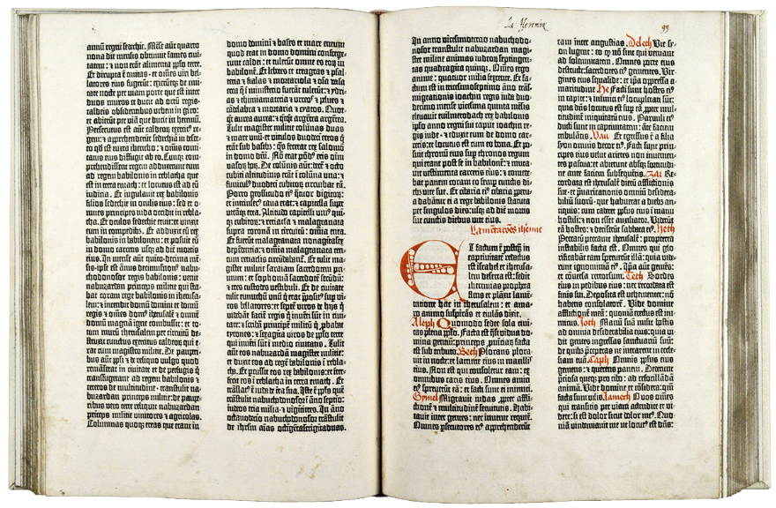
What Does the Bible Say?
In early Bibles there were no chapters and verses
There is no authoritative basis for the divisions we now use in the Bible. The chapter and verse divisions were added to the Bible for the sake of convenience. A man named Stephen Langton divided the Bible into chapters in the year A.D. 1227.
Notes:
Chapters and verses were not added until 1227 with no particular authoritative basis by The Archbishop of Canterbury, Stephen Langton simply for the convenience of finding certain passages with ease.

Slide 14
What Does the Bible Say?
In Exodus 20:2-17 there are:
16 verses
5 statements
1 Instruction
1 explanation
12 commandments
So How do we get ten commandments?
Notes:
In Exodus 20:2-17 and in Deuteronomy 5:6-21 there are 16 verses comprised of the following.
5 statements:
I am the LORD your God, who brought you out of the land of Egypt, out of the house of slavery.
For I, the LORD, your God, am a jealous God, inflicting punishment for their ancestors’ wickedness on the children of those who hate me, down to the third and fourth generation;
but showing love down to the thousandth generation of those who love me and keep my commandments.
six days you may labor and do all your work,
but the seventh day is a Sabbath of the LORD your God.
1 Instruction
You shall not do any work, either you, your son or your daughter, your male or female slave, your work animal, or the resident alien within your gates.
1 explanation
but on the seventh day he rested. That is why the LORD has blessed the Sabbath day and made it holy.
12 commandments
Have no God before me
Make no idols
Bow down to no idols
Do not use the Lord’s name in vain
Remember the Sabbath
Do no work on the Sabbath
Honor your father and mother
Do not kill
Do not commit adultery
Do not steal
Do not bear false witness
Do not covet a man’s wife
Do not covet a man’s possessions

Slide 15
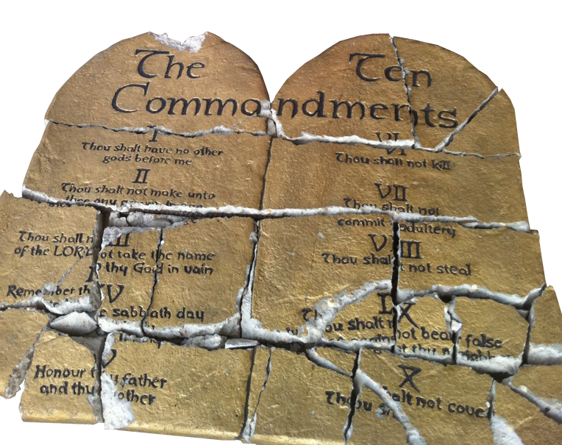
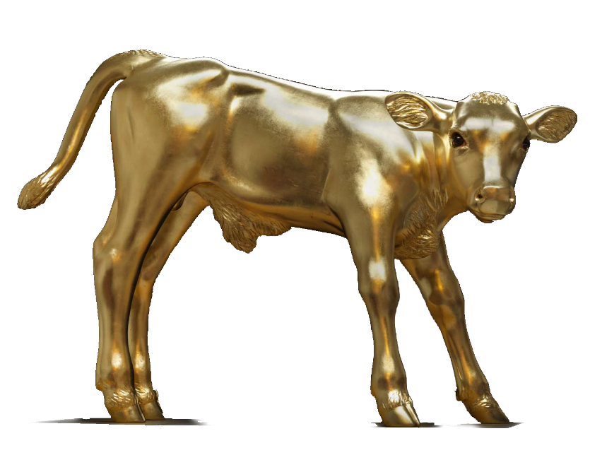
What Does the Bible Say?
Where in the Bible does is say there are 10 commandments?
Exodus 34:28 and Deuteronomy 4:13 and 10:2-4.
After Moses found the Golden Calf, he smashed the tablets but God had him make two more blank tablets and take them to the mountain where God inscribed upon them the ten words
In the original Hebrew the commandments are referred to as the ten words which are actually separate category headings for the 613 separate commandments handed down to Moses from God.
Notes:
Exodus 34:28
So Moses was there with the LORD for forty days and forty nights, without eating any food or drinking any water, and he wrote on the tablets the words of the covenant, the ten words.
Deuteronomy 4:13
He proclaimed to you his covenant, which he commanded you to keep: the ten words, which he wrote on two stone tablets.
Deuteronomy 10:4
The LORD then wrote on the tablets, as he had written before, the ten words that the LORD had spoken to you on the mountain from the midst of the fire on the day of the assembly; and the LORD gave them to me.
Jewish tradition holds that the first three commandments, having to do specifically with God, were written on one tablet, and the last seven, having to do specifically with fellow man was written on the second tablet.
In the original Hebrew the commandments are referred to as the ten words which are actually separate category headings for the 613 separate commandments handed down by Moses from God.

Slide 16
What Does the Bible Say?
So, Did Catholics change the 10 Commandments to satisfy their desire to worship Idols?
“The division and numbering of the Commandments have varied in the course of history. The present catechism follows the division of the Commandments established by St. Augustine, (354 – 430 AD) which has become traditional in the Catholic Church. It is also that of the Lutheran confessions. The Greek Fathers worked out a slightly different division, which is found in the Orthodox Churches and Reformed communities.”
CCC 2066
Notes:
The ten commandments have been in their present format in the Catholic Church since St. Augustine defined them around 400 AD

Slide 17
A Common Misunderstanding
In fact, it was not the Protestants who changed the divisions of the commandments but the early Greek Orthodox Church.
Only after the abbreviated forms of the ten commandments became popular did some Protestant denominations accept the Orthodox versions.

Slide 18
A Common Misunderstanding
So, did Catholics throw out the second commandment to justify idol worship?
Did Protestants modify the first commandment to justify their stance that Catholics are idolaters?
Not at all,
Notes:
A common misunderstanding between Catholics and Protestants is the order and content of the ten commandments, the chief issue being the practice of worshiping idols.
Protestants claim that the Catholic Church threw out the second commandment because it did not agree with their practice of worshiping idols.
Some Catholics claim that Protestants specifically reorganized the first commandment to prove scripturally that Catholics worship idols.
Both statements are completely false.
First, the Lutheran Church was the first church to protest Catholicism and split from the Catholic Church and while Luther eventually did throw out seven books of the Old Testament, and rearranged a bit of text to better suit his personal beliefs, he did not change the Ten Commandments and in fact, the Lutheran Church today holds to the same order and listing of the Commandments as the Catholic Church.

Slide 19
A Common Misunderstanding
With logic and reason we can demonstrate:
Catholics do not hide the second commandment but have used the same listing of the ten commandments since the beginning of the church.
Protestants did not modify the divisions and Lutherans still use the same version as Catholics.
Notes:
While Protestants did not modify the ten commandments to suit their anti-Catholic views, they certainly did find it convenient to use the Eastern Orthodox versions which had split the first section into the two used by most Protestants today.

Slide 20
A Common Misunderstanding
In all cases what has become the simplified versions became so a thousand years ago in order to make teaching them easier.
So the five verses that make up the first commandment were distilled into one commandment by the Catholic Church:
“You shall have no other god before Me.”
Notes:
All of the commands listed in the scriptures concerning worshipping only one God are condensed onto this command. Because if we worship only one God, who does not tolerate worship of anyone or anything but Himself, we will obey His commands concerning how and what we worship.
One God, idols, bowing down, all encompass the same commandment. There is but one true God and we worship Him alone.

Slide 21
A Common Misunderstanding
While later Protestants used the divided verses of the Eastern Church as two commandments:
“You shall have no other god before Me.”
“You shall not make any graven image”
Notes:
This is an interesting point because contrary to the Protestant understanding of these commandments, the Eastern Churches are steeped in iconography and statues.

Slide 22
A Common Misunderstanding
Catholics also divided Deuteronomy 5:21 into two commandments:
“You shall not covet your neighbors wife”
“You shall not covet your neighbors belongings”
While Protestants retained this verse as one commandment:
“You Shall Not Covet”
Notes:
Catholics divided Deuteronomy 5:21 into two commandments yet somehow, this is not a contentious point.

Slide 23
A Common Misunderstanding
Catholic 10 Commandments
Protestant 10 Commandments
You shall have no other Gods before me
Do not take the Lords name in vain
Remember the Sabbath and keep it holy
Honor your mother and father
You shall not murder
You shall not commit adultery
You shall not steal
You shall not bear false witness against your neighbor
You shall not covet your neighbors wife
You shall not covet your neighbors property
You shall have no other gods but me.
You shall not make unto you any graven images
You shall not take the name of the Lord your God in vain
You shall remember the Sabbath and keep it holy
Honor your mother and father
You shall not kill
You shall not commit adultery
You shall not steal
You shall not bear false witness
You shall not covet anything that belongs to your neighbor
Notes:
These are the popular, abbreviated versions of the ten commandments as outlined by the Catholics Church and as popularized by most Protestant Churches after their split from Luther.
The two major differences are in red.

Slide 24
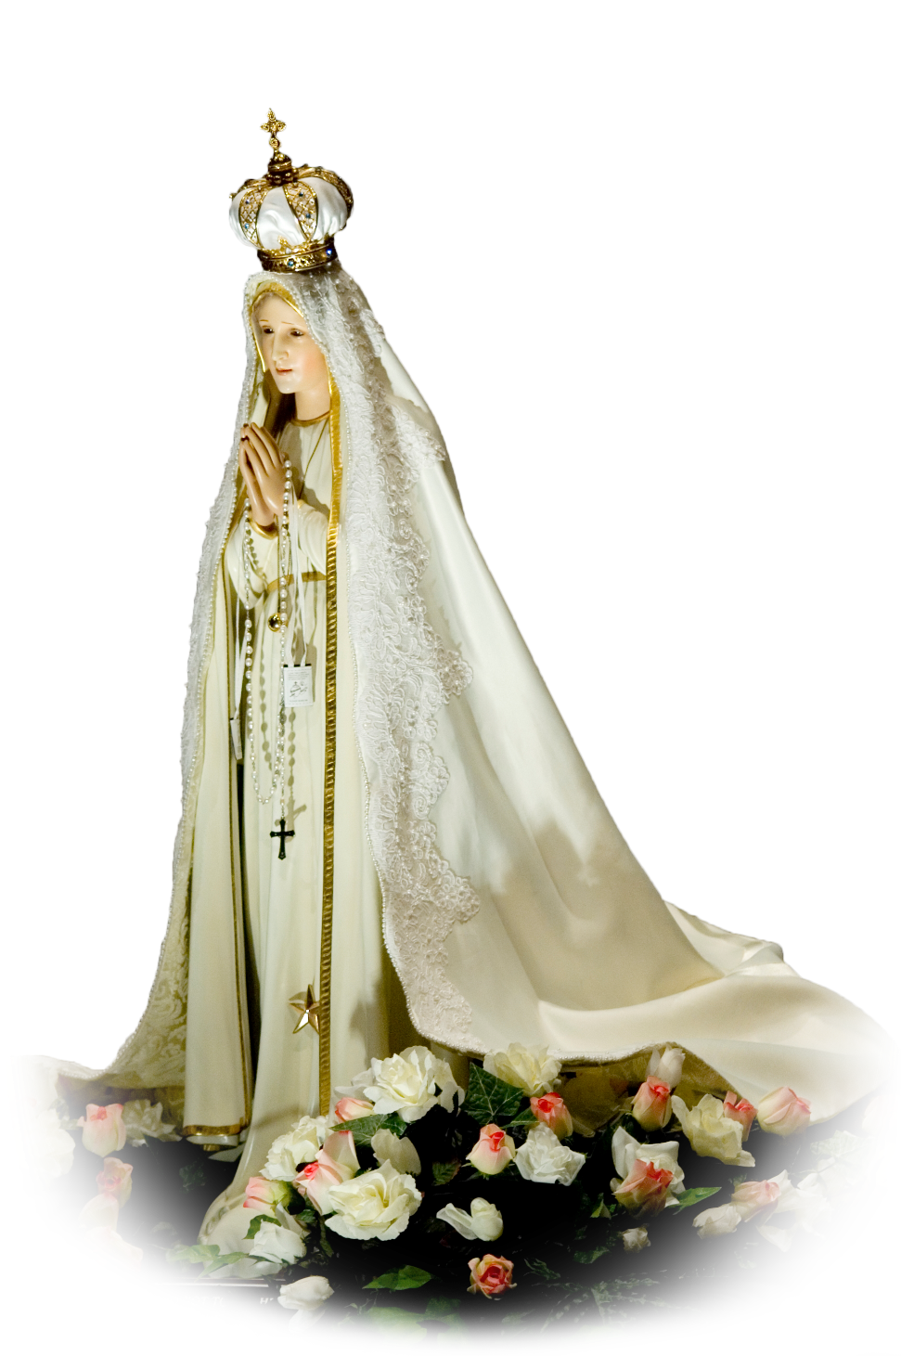
A Common Misunderstanding
And this leads us to the basic misunderstanding of the Commandments between Catholic and Protestant:
Idolatry
The mistaken belief that Catholics indulge in idolatry and worship of people and things other than God.
Notes:
So having logically and with reason removed all mystery about the scriptural basis for the ten commandments, and having shown that there is no difference in the scriptures recording the commandments, what is the problem?
In a word, Idolatry.
We know that Catholics do not practice idolatry, but how do we explain this in a way non Catholics will understand?
We can start with the scriptures.

Slide 25
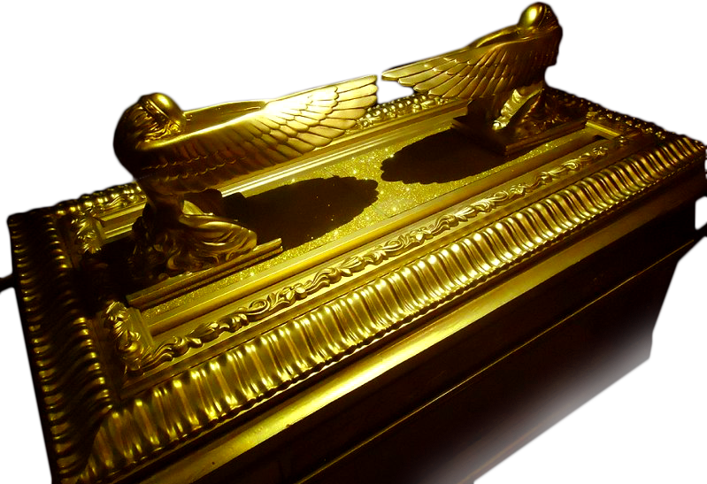
Idolatry?
If it is true that we are to make no graven image of anything, then why, only five chapters later did God command Moses to make Cherubim of the purest Gold?
Exodus 25:18-20
Notes:
Then why do Catholics have an abundance of statures, paintings and icons of religious figures and symbols in their churches?
Why do Catholics make statues and graven images?
Because God told them to. Several times. Clearly, explicitly and in great detail he told them to make statues and adornments in honor of Him.

Slide 26
Idolatry?
Or in the desert to erect a serpent of bronze which when gazed upon would heal snake bites?
Exodus 25:18-20
Or the Temple of Solomon, adorned with Cherubim, palm trees, flowers and pomegranates given “by the hand of the LORD, to make him understand it—the working out of the whole design.”
1 Chronicles 28:18-19
Notes:
God instructed Moses to make a bronze serpent and erect in on a staff in the desert so that anyone bitten by a snake would only have to gaze upon it and be healed.
This is one of the scriptural basis’ of images created for ritual use.

Slide 27
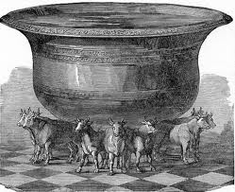
Idolatry?
Or the twelve oxen, facing all the points of the compass supporting the “molten sea”
1 Kings 7:23-26
Notes:
God instructed Moses to make a bronze serpent and erect in on a staff in the desert so that anyone bitten by a snake would only have to gaze upon it and be healed.
This is one of the scriptural basis’ of images created for ritual use.

Slide 28
Idolatry?
Deuteronomy 4:15-18:
¹⁵ Because you saw no form at all on the day the LORD spoke to you at Horeb from the midst of the fire, be strictly on your guard ¹⁶ not to act corruptly by fashioning an idol for yourselves to represent any figure, whether it be the form of a man or of a woman, ¹⁷ the form of any animal on the earth, the form of any bird that flies in the sky, ¹⁸ the form of anything that crawls on the ground, or the form of any fish in the waters under the earth.
Notes:
Protestants will use this passage to indicate that since God had no form to Moses or the Israelites, there can therefore be no form given to God and no painting or statue of God is permitted. Well, we already know that God not only permits statues, but specifically directed their construction and use and while the ancient Israelites may have been prohibited from depicting God in any way, He did finally reveal Himself in
Daniel 7:9
⁹ As I watched, Thrones were set up and the Ancient of Days took his throne. His clothing was white as snow, the hair on his head like pure wool; His throne was flames of fire, with wheels of burning fire.
This is the form often used to illustrate God in Protestant Bibles and story books.

Slide 29
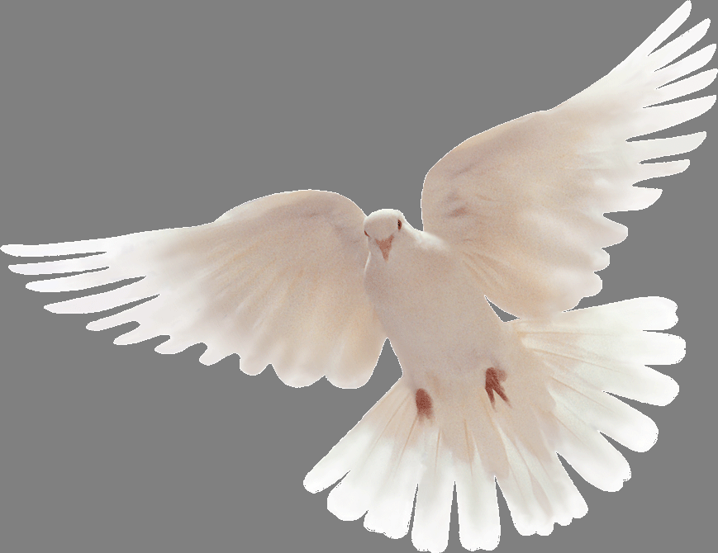
Idolatry?
The Holy Spirit also revealed itself
in the New Testament in at least
two forms:
Notes:
But the Holy Spirit did reveal itself physically in at least two forms in the New Testament; once in the form of a dove when Jesus was baptized and again as tongues of flame at Pentecost. Protestants often use these two images as well in illustrations and in symbols to display on their cars, or wear as a lapel pin.

Slide 30
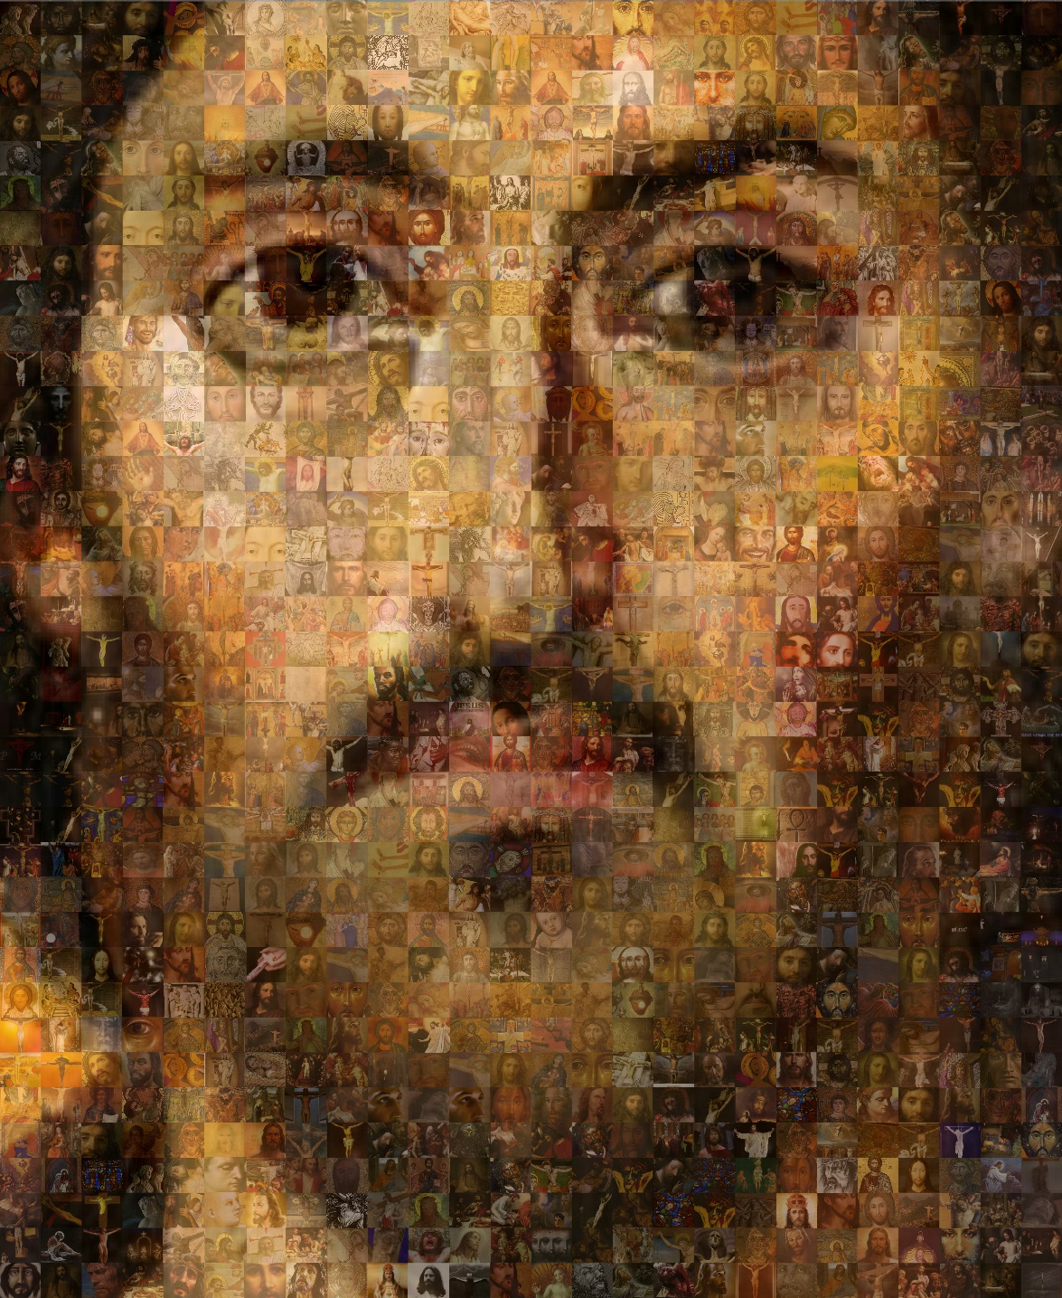
Idolatry?
And God revealed himself most obviously in the form of Christ on earth.
Notes:
The most obvious image of God is in Christ Himself, God made man, living and of course visible on earth. When the wise men came to Bethlehem they “saw” the Babe, lying in a manger. The perfect icon of God Himself.
And I like to think that since at least half of Jesus’ DNA was from God, he probably looked at least a little like God Himself must have wanted us to think of Him.

Slide 31
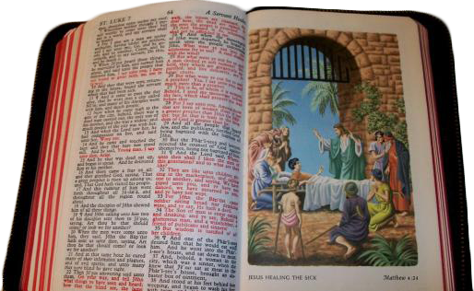
Idolatry?
You may ask a protestant friend if he has an illustrated bible, and if so, doesn’t this defy the prohibition against images? If he says “No, because we don’t worship these images.” you may have the beginnings of an understanding of Catholic Doctrine.
Notes:
Despite the adamant assertion that Catholics are idolaters, Protestants actually use many illustrations in their religious life including richly illustrated Bibles, which in their strict interpretation of their second commandment should be sinful…

Slide 32
Idolatry?
Why would God forbid the making of statues, then do an about face and give such explicit instructions for building them?
“The Christian veneration of images is not contrary to the first commandment which proscribes idols. Indeed, "the honor rendered to an image passes to its prototype," and "whoever venerates an image venerates the person portrayed in it."⁷⁰ The honor paid to sacred images is a "respectful veneration," not the adoration due to God alone:
Religious worship is not directed to images in themselves, considered as mere things, but under their distinctive aspect as images leading us on to God incarnate. The movement toward the image does not terminate in it as image, but tends toward that whose image it is.”
CCC 2132

Slide 33
Idolatry?
“The Church absolutely recognizes and condemns the sin of idolatry. What anti-Catholics fail to recognize is the distinction between thinking a piece of stone or plaster is a god and desiring to visually remember Christ and the saints in heaven by making statues in their honor. The making and use of religious statues is a thoroughly biblical practice. Anyone who says otherwise doesn’t know his Bible. “
“Do Catholics Worship Statues?” A Catholic Answers tract (http://www.catholic.com/tracts/do-catholics-worship-statues)

Slide 34
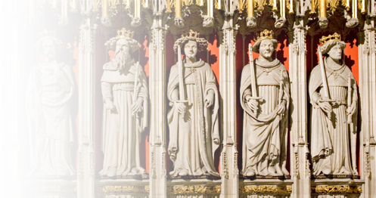
Worshiping the Saints?
So we’ve scripturally proved the existence and importance of statues in the Bible.

Slide 35
Worshiping the Saints?
You might convince someone that Catholics don’t worship idols, but the response may be, “Okay, but you do worship Mary and the Saints.”
Now we must explain the difference between worship and veneration and how they relate to Catholic Theology.

Slide 36
Worshiping the Saints?
It’s in the language, three levels of “worship” from the Greek:
Dulia; the respect due exceptional people
Hyperdulia; beyond dulia, as that afforded to Mary
Latria; the highest level of honor and worship reserved entirely for God
Notes:
We always need to remember that the English language is not necessarily the best language to understand the Bible in.
Dulia; the respect due exceptional people
Hyperdulia; Beyond dulia, as that afforded to Mary
Latria; the highest level of honor and worship reserved entirely for God

Slide 37
Worshiping the Saints?
It was clearly understood that latria was the highest level reserved only for God.
Eventually these words merged in Old English to weorthscipe, which means to be worthy of honor, respect, or dignity, then finally into the modern worship.
Notes:
With the three words merged into one “worship” there was a shortage of separate words to describe the feelings given to the saints and the lines became blurred.
So we have used other meanings such as veneration, and intercessors to try and describe our meanings.

Slide 38
Worshiping the Saints?
There are generally two scriptures used to discredit our beliefs about the saints. First:
1 Timothy 2:5
⁵ For there is one God. There is also one mediator between God and the human race, Christ Jesus, Himself human.
Ostensibly proving that Saints are NOT the scriptural intercessors of our prayers.
Notes:
Protestants will use two particular passages to prove that saints are not intercessors and that praying to them is non scriptural.

Slide 39
Worshiping the Saints?
Remember, read all the words.
1 Timothy 2:1-6
¹ First of all, then, I ask that supplications, prayers, petitions, and thanksgivings be offered for everyone, ² for kings and for all in authority, that we may lead a quiet and tranquil life in all devotion and dignity. ³ This is good and pleasing to God our savior, ⁴ who wills everyone to be saved and to come to knowledge of the truth. ⁵ For there is one God. There is also one mediator between God and the human race, Christ Jesus, Himself human, ⁶ who gave Himself as ransom for all. This was the testimony at the proper time.
Notes:
This is another example of selective scripture, chosen by itself to prove a point.
1 Timothy 2:1-7
¹ First of all, then, I ask that supplications, prayers, petitions, and thanksgivings be offered for everyone, ² for kings and for all in authority, that we may lead a quiet and tranquil life in all devotion and dignity. ³ This is good and pleasing to God our savior, ⁴ who wills everyone to be saved and to come to knowledge of the truth. ⁵ For there is one God. There is also one mediator between God and the human race, Christ Jesus, Himself human, ⁶ who gave Himself as ransom for all. This was the testimony at the proper time. ⁷ For this I was appointed preacher and apostle (I am speaking the truth, I am not lying), teacher of the Gentiles in faith and truth.

Slide 40
Worshiping the Saints?
Consider further:
Romans 15:30
³⁰ I urge you, [brothers,] by our Lord Jesus Christ and by the love of the Spirit, to join me in the struggle by your prayers to God on my behalf
Colossians 4:3
³ at the same time, pray for us, too, that God may open a door to us for the word, to speak of the mystery of Christ, for which I am in prison
Notes:
Consider further:
Romans 15:30
³⁰ I urge you, [brothers,] by our Lord Jesus Christ and by the love of the Spirit, to join me in the struggle by your prayers to God on my behalf
Colossians 4:3
³ at the same time, pray for us, too, that God may open a door to us for the word, to speak of the mystery of Christ, for which I am in prison

Slide 41
Worshiping the Saints?
2 Thessalonians 1:11
¹¹ To this end, we always pray for you, that our God may make you worthy of his calling and powerfully bring to fulfillment every good purpose and every effort of faith,
2 Thessalonians 3:1
¹ Finally, brothers, pray for us, so that the word of the Lord may speed forward and be glorified, as it did among you
Paul clearly asks other living human beings to intercede with prayer in his behalf.
Notes:
2 Thessalonians 1:11
¹¹ To this end, we always pray for you, that our God may make you worthy of his calling and powerfully bring to fulfillment every good purpose and every effort of faith,
2 Thessalonians 3:1
¹ Finally, brothers, pray for us, so that the word of the Lord may speed forward and be glorified, as it did among you
Here Paul is asking other living human beings to intercede on his behalf and pray for his requests. (Note: Living is a key word here.)

Slide 42
Worshiping the Saints?
Living human beings, not the dead.
Deuteronomy 18:10-12
¹⁰ Let there not be found among you anyone who causes their son or daughter to pass through the fire, or practices divination, or is a soothsayer, augur, or sorcerer, ¹¹ or who casts spells, consults ghosts and spirits, or seeks oracles from the dead. ¹² Anyone who does such things is an abomination to the LORD, and because of such abominations the LORD, your God, is dispossessing them before you.
Notes:
This is the argument against praying to the dead. It is an abomination to the LORD

Slide 43
Worshiping the Saints?
Living human beings, not the dead.
Mark 12:26-27 ²⁶ As for the dead being raised, have you not read in the Book of Moses, in the passage about the bush, how God told him, ‘I am the God of Abraham, [the] God of Isaac, and [the] God of Jacob’? ²⁷ He is not God of the dead but of the living. You are greatly misled.
Mark 9:4 ⁴ Then Elijah appeared to them along with Moses, and they were conversing with Jesus.
Notes:
Practically the entire New Testament is framed around man’s salvation, the end goal being eternal life with God in heaven. Eternal LIFE. God is the God of the Living… NOT the dead.
Just an aside: when the rapture comes we WANT to be left behind. In every case in the Bible when one is taken and another left behind, it is the righteous person left behind, the sinner who is taken.
Noah after the flood, The Israelites at the red being the most obvious.

Slide 44
Worshiping the Saints?
So the saints are alive in heaven, why do we think they can hear our prayers?
From the mouth of Jesus Himself comes the parable of Lazarus and the rich man who speaks to “Father Abraham” across the abyss in Luke 16:19-30.
Jesus tells us that the prophets and the early fathers are alive in heaven and can communicate quite well.
Notes:
Luke 16:19-30
[19-22 Paraphrased ] There was a poor man named Lazarus who lay at the door of a rich man. They both died and Lazarus was sent to heaven while the rich man went to the netherworld.
²³ and from the netherworld, where he was in torment, he raised his eyes and saw Abraham far off and Lazarus at his side. ²⁴ And he cried out, ‘Father Abraham, have pity on me. Send Lazarus to dip the tip of his finger in water and cool my tongue, for I am suffering torment in these flames.’ ²⁵ Abraham replied, ‘My child, remember that you received what was good during your lifetime while Lazarus likewise received what was bad; but now he is comforted here, whereas you are tormented.
[26-31 Paraphrased] and there is a great chasm between us that prevents us from crossing in either direction. The rich man then asks Abraham to send Lazarus to warn his brothers of his torment and Abraham tells him if they haven’t listened to Moses and the prophets they won’t believe even if someone rises from the dead.

Slide 45
Worshiping the Saints?
Revelation 5:8
⁸ When he took [the scroll], the four living creatures and the twenty-four elders fell down before the Lamb. Each of the elders held a harp and gold bowls filled with incense, which are the prayers of the saints.
The incense the elders offer to God are the prayers of the saints. Interceding for us, on our behalf.
Notes:
Luke 16:19-30
[19-22 Paraphrased ] There was a poor man named Lazarus who lay at the door of a rich man. They both died and Lazarus was sent to heaven while the rich man went to the netherworld.
²³ and from the netherworld, where he was in torment, he raised his eyes and saw Abraham far off and Lazarus at his side. ²⁴ And he cried out, ‘Father Abraham, have pity on me. Send Lazarus to dip the tip of his finger in water and cool my tongue, for I am suffering torment in these flames.’ ²⁵ Abraham replied, ‘My child, remember that you received what was good during your lifetime while Lazarus likewise received what was bad; but now he is comforted here, whereas you are tormented.
[26-31 Paraphrased] and there is a great chasm between us that prevents us from crossing in either direction. The rich man then asks Abraham to send Lazarus to warn his brothers of his torment and Abraham tells him if they haven’t listened to Moses and the prophets they won’t believe even if someone rises from the dead.

Slide 46
Idolatry - Catechism
The sacred image, the liturgical icon, principally represents Christ. It cannot represent the invisible and incomprehensible God, but the incarnation of the Son of God has ushered in a new "economy" of images
CCC 1159
Human life finds its unity in the adoration of the one God. the commandment to worship the Lord alone integrates man and saves him from an endless disintegration. Idolatry is a perversion of man's innate religious sense. An idolater is someone who "transfers his indestructible notion of God to anything other than God.“
CCC 2114
Notes:
The sacred image, the liturgical icon, principally represents Christ. It cannot represent the invisible and incomprehensible God, but the incarnation of the Son of God has ushered in a new "economy" of images
CCC 1159
Human life finds its unity in the adoration of the one God. the commandment to worship the Lord alone integrates man and saves him from an endless disintegration. Idolatry is a perversion of man's innate religious sense. An idolater is someone who "transfers his indestructible notion of God to anything other than God.“
CCC 2114

Slide 47
Prayer to Saints – The Catechism
The intercession of the saints. "Being more closely united to Christ, those who dwell in heaven fix the whole Church more firmly in holiness. . . . They do not cease to intercede with the Father for us, as they proffer the merits which they acquired on earth through the one mediator between God and men, Christ Jesus . . . . So by their fraternal concern is our weakness greatly helped.
CCC 956
Notes:
Luke 16:19-30
[19-22 Paraphrased ] There was a poor man named Lazarus who lay at the door of a rich man. They both died and Lazarus was sent to heaven while the rich man went to the netherworld.
²³ and from the netherworld, where he was in torment, he raised his eyes and saw Abraham far off and Lazarus at his side. ²⁴ And he cried out, ‘Father Abraham, have pity on me. Send Lazarus to dip the tip of his finger in water and cool my tongue, for I am suffering torment in these flames.’ ²⁵ Abraham replied, ‘My child, remember that you received what was good during your lifetime while Lazarus likewise received what was bad; but now he is comforted here, whereas you are tormented.
[26-31 Paraphrased] and there is a great chasm between us that prevents us from crossing in either direction. The rich man then asks Abraham to send Lazarus to warn his brothers of his torment and Abraham tells him if they haven’t listened to Moses and the prophets they won’t believe even if someone rises from the dead.

Slide 48
Apologetics
The intercession of the saints. "Being more closely united to Christ, those who dwell in heaven fix the whole Church more firmly in holiness. . . . They do not cease to intercede with the Father for us, as they proffer the merits which they acquired on earth through the one mediator between God and men, Christ Jesus . . . . So by their fraternal concern is our weakness greatly helped.
CCC 956
Notes:
Luke 16:19-30
[19-22 Paraphrased ] There was a poor man named Lazarus who lay at the door of a rich man. They both died and Lazarus was sent to heaven while the rich man went to the netherworld.
²³ and from the netherworld, where he was in torment, he raised his eyes and saw Abraham far off and Lazarus at his side. ²⁴ And he cried out, ‘Father Abraham, have pity on me. Send Lazarus to dip the tip of his finger in water and cool my tongue, for I am suffering torment in these flames.’ ²⁵ Abraham replied, ‘My child, remember that you received what was good during your lifetime while Lazarus likewise received what was bad; but now he is comforted here, whereas you are tormented.
[26-31 Paraphrased] and there is a great chasm between us that prevents us from crossing in either direction. The rich man then asks Abraham to send Lazarus to warn his brothers of his torment and Abraham tells him if they haven’t listened to Moses and the prophets they won’t believe even if someone rises from the dead.

Slide 49
Apoplogetics
Remember:
NOTHING in the teachings of the Catholic Church contradicts ANYTHING in the Bible.
NOTHING in the Bible contradicts ANY of the teachings of the Catholic Church.
Notes:
GET THIS INTO YOUR HEADS!
This is your armor. When you understand this, you cannot be beaten.
Protestant theology says we are all free to interpret the Bible as we see fit in our own way. That belief will force them to concede that your interpretation is as at least as good as theirs.
John Marignoni says that with this understanding the best your opponent can hope for is a tie, and the worst you an suffer is a tie.
It can only come down to “well, that’s my interpretation.”

Slide 50
Be Armed and Ready, but Willing to Retreat
Never be afraid to say:
I don’t know, but I’ll find out and get back to you.
You have all the answers backed by the “the church of the living God, the pillar and foundation of truth.”
So FIND OUT and GET BACK TO THEM
Notes:
Now you have the advantage.
Find out and GET BACK TO THEM!
You can look it up. Do the research, find a talk by Scott Hahn or John Martignoni and give it to them.
You have all the answers backed by the “the church of the living God, the pillar and foundation of truth.”
But ALWAYS GET BACK TO THEM!
I got into a discussion with a guy at the Rally for Life down in Columbia a few years ago.
I made the mistake once of giving the guy my e-mail address but not getting his…
He told me he would send me his e-mail and finish the discussion but he never did.
I imagine he told some friend of his about his discussion with a Catholic and the friend probably told him to drop it
I never could finish what I had to say to him and I’ve regretted it ever since.
I hope what I did tell him might have sparked some interest, but I will never know.
ALWAYS GET BACK TO THEM!

Slide 51
Lesson Documents
This Presentation and Handout:
www.cmhager.com/faith/documents

Slide 52
Apologetics… Defending the Faith
Scripture in Support of Our Catholic Beliefs

